Slide 1

Suicide Deaths in the United States
Updated April 2023

Slide 2
Suicide rates increased among both males and females in the U.S. from 2011 to 2021.
Age-adjusted rate per 100,000
Source: CDC, 2021
Notes:
From 2011 to 2021, the total age-adjusted suicide death rate increased from 12.3 to 14.1 per 100,000 people. During that time period, the rate increased from 20 to 22.8 per 100,000 for males. Among females, the rate increased from 5.2 in 2011 to 5.7 in 2021.
SOURCE: Centers for Disease Control and Prevention. (2021). 1999-2020 Wide ranging online data for epidemiological research (WONDER), multiple cause of death files [Data file]. National Center for Health Statistics. https://wonder.cdc.gov/Deaths-by-Underlying-Cause.html

Slide 3
Suicides outnumbered homicides in the U.S. from 2011 to 2020.
Age-adjusted rate per 100,000
Source: CDC, 2021
Notes:
Suicides consistently outnumber homicides. The homicide rate has not consistently shown the upward trend we see with the suicide rate, but the homicide rate did increase from 6 per 100,000 in 2019 to 7.8 per 100,000 in 2020.
SOURCE: Centers for Disease Control and Prevention. (2021). 1999-2020 Wide ranging online data for epidemiological research (WONDER), multiple cause of death files [Data file]. National Center for Health Statistics. https://wonder.cdc.gov/Deaths-by-Underlying-Cause.html

Slide 4
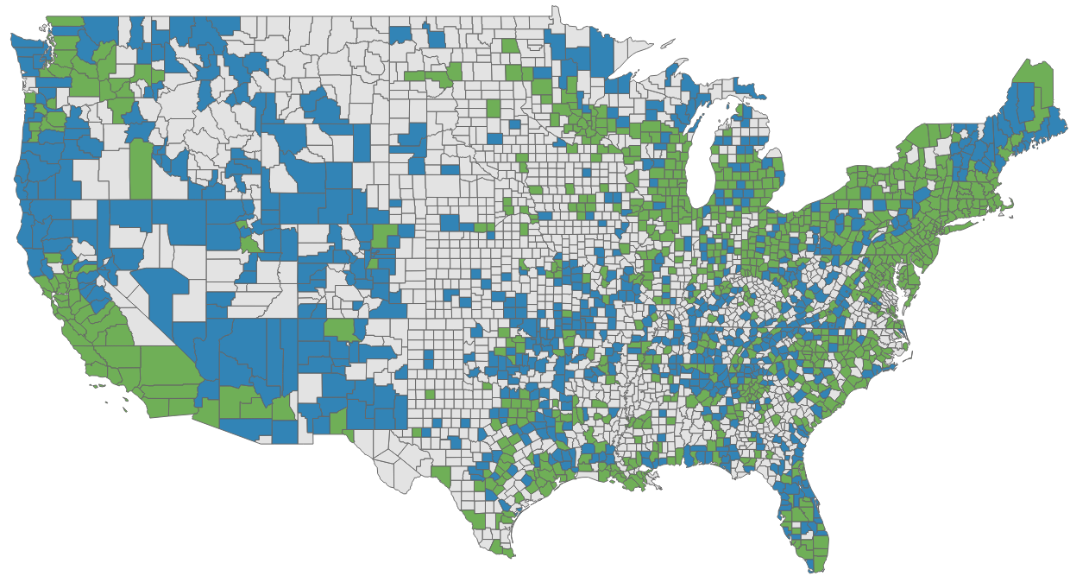

County-Level Suicide Rates per 100,000
in the U.S. from 2018 to 2021
Source: CDC Wonder, 2018-2021
Notes:
Between 2018 and 2021, suicide rates were highest in the region that includes Alaska and the western and northwestern United States, except in southern California and parts of Washington. In the past two decades, suicide rates have been consistently higher in rural areas than in urban areas in the U.S. Between 2000-2020, suicide rates increased 46% in non-metro areas compared to 27.3% in metro areas.
High crude rate (blue) ranges are from 19 to 120 per 100,000 and low crude rate (green) ranges are from 5 to 18 per 100,000. Death rates are unreliable when the rate is calculated with a numerator less than 20; death rates are suppressed when the rate is calculated with a numerator of nine or fewer.
SOURCES:
Centers for Disease Control and Prevention. (2023, June). 2018-2021 United States, age-adjusted death rates per 100,000 population. All injury, suicide, all races, all ethnicities, both sexes, all ages. [Map]. CDC Wonder. https://wonder.cdc.gov/
Centers for Disease Control and Prevention. (2023). Suicide in rural America. https://www.cdc.gov/ruralhealth/Suicide.html#:~:text=In%20the%20past%20two%20decades,to%2027.3%25%20in%20metro%20areas

Slide 5

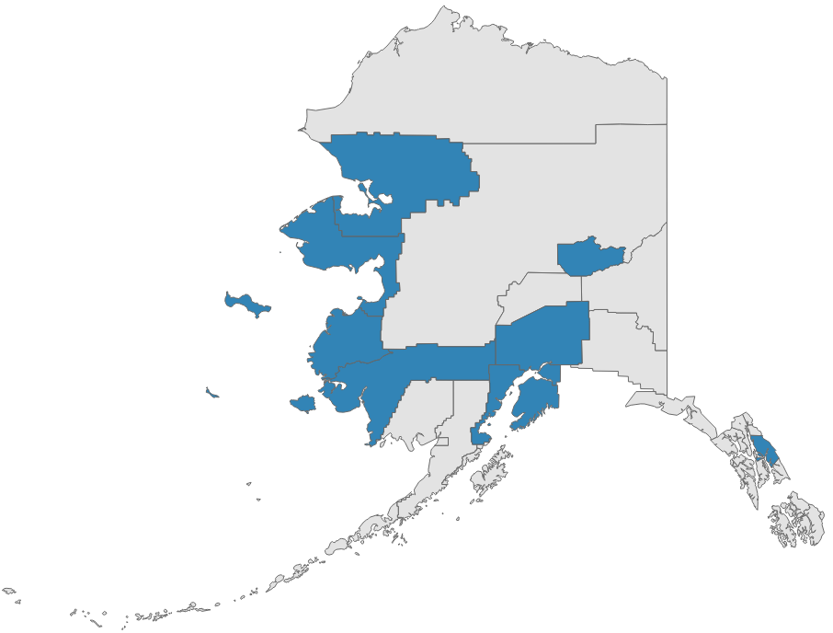
County-Level Suicide Rates per 100,000
in the U.S. from 2018 to 2021, continued
Hawaii
Alaska
Source: CDC Wonder, 2018-2021
Notes:
Between 2018 and 2021, Alaska had the highest suicide rates in the U.S. in several counties (blue shading). Hawaii had lower suicide rates in some counties (green shading) but had some counties with the second highest suicide rates in the U.S. (blue shading).
Death rates are unreliable when the rate is calculated with a numerator less than 20; death rates are suppressed when the rate is calculated with a numerator of nine or fewer.
SOURCE: Centers for Disease Control and Prevention. (2022, January). 2014-2020 United States, age-adjusted death rates per 100,000 population. All injury, suicide, all races, all ethnicities, both sexes, all ages. [Map]. CDC Wonder. https://wonder.cdc.gov/

Slide 6
Suicide by Age

Slide 7
Suicide Rates by Age in the U.S., 2015-2020
Crude rate per 100,000
Source: CDC, 2021
Notes:
Between 2015 and 2020, suicide rates increased for those ages 15 to 24, 25 to 34, and 35 to 44.
For the 45 to 54 age group, the rate was fairly steady and then decreased around 2019. For those ages 55 to 64, rates increased steadily starting in 2015, followed by a downward turn in 2018. The rate for the 65+ age group was steady until 2017, and then increased until 2018, when it decreased.
SOURCE: Centers for Disease Control and Prevention. (2021). 1999-2020 Wide ranging online data for epidemiological research (WONDER), multiple cause of death files [Data file]. National Center for Health Statistics. http://wonder.cdc.gov/ucd-icd10.html

Slide 8
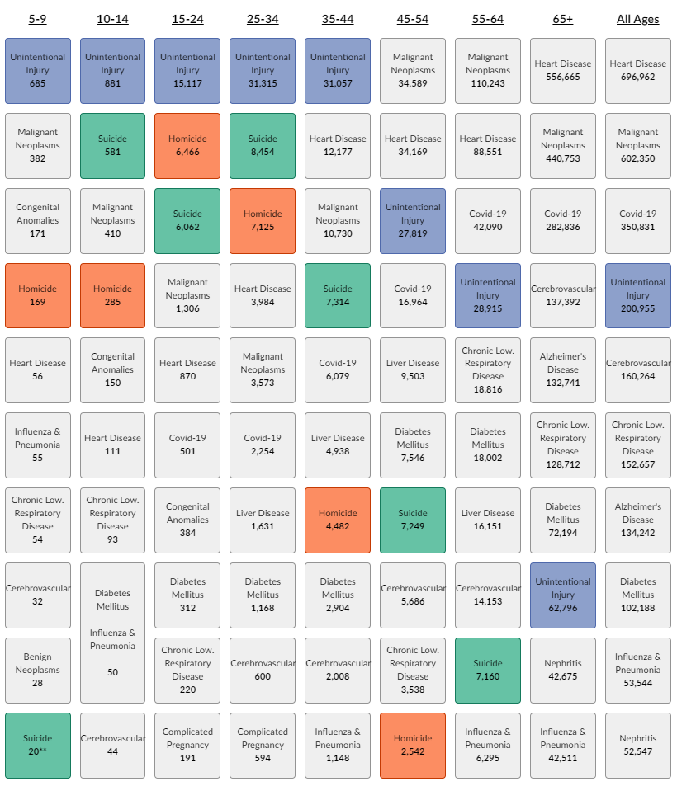
Ten Leading Causes of Death by Age (U.S., 2020)
Age Groups
Crude Rate per 100,000 Ranking
Source: CDC, 2021
Notes:
In 2020, suicide was the second leading cause of death for those ages 10 to 14 and 25 to 34. Suicide was the third leading cause of death for ages 15 to 24, the fourth leading cause of death for ages 35 to 44, and the seventh leading cause of death for ages 55 to 64. Although suicide has historically been among the top ten leading causes of death for all ages combined, it was not in 2020. In 2020, COVID-19 became the third leading cause of death.
SOURCE: Centers for Disease Control and Prevention. (2021). Web-based injury statistics query and reporting system (WISQARS). National Center for Injury Prevention and Control. www.cdc.gov/injury/wisqars

Slide 9
Suicidal Thoughts and Suicide Attempts

Slide 10
Suicidal Behavior (U.S., 2021)
45,979
Suicide deaths (includes adults and youth)
1,748,000
Reported suicide attempts* (18+)
3,525,000
Made any suicide plans in past year* (18+)
12,303,000
Had serious thoughts of suicide in past year* (18+)
*Self-report
Source: CDC, 2021; SAMHSA, 2021
Notes:
Of those who have serious thoughts of suicide, many fewer make suicide plans. Fewer still report suicide attempts or die by suicide.
SOURCE: Center for Behavioral Health Statistics and Quality. (2021). 2020 National survey on drug use and health: Detailed tables. Substance Abuse and Mental Health Services Administration. https://www.samhsa.gov/data/report/2020-nsduh-detailed-tables
Table 858A
Centers for Disease Control and Prevention. (2021). 1999-2020 Wide ranging online data for epidemiological research (WONDER), multiple cause of death files [Data file]. National Center for Health Statistics. http://wonder.cdc.gov/ucd-icd10.html

Slide 11
A higher percentage of all ages (18+) had suicidal thoughts than made plans or attempted suicide (U.S., 2021).
Ages 18-25
Ages 26-49
Ages 50+
Source: SAMHSA, 2023
Notes:
Across all age groups, a greater percentage of adults think about suicide than make a suicide plan or attempt suicide.
SOURCE: Center for Behavioral Health Statistics and Quality. (2023). 2021 National survey on drug use and health: Detailed tables. Substance Abuse and Mental Health Services Administration. https://www.samhsa.gov/data/report/2021-nsduh-detailed-tables
Tables 8.54B, 8.55B, and 8.56B (Totals)

Slide 12
More females than males had suicidal thoughts or made suicide plans and attempts (U.S., 2021).
Ages 18+
Source: SAMHSA, 2023
Notes:
In 2021, females were at greater risk for suicidal thoughts, suicide attempts, and medically treated suicide attempts than males. However, in 2021, males died by suicide at a higher rate than females (22.8 per 100, 000 and 5.7 per 100,000, respectively, as shown on slide 2).
SOURCE: Center for Behavioral Health Statistics and Quality. (2023). 2021 National survey on drug use and health: Detailed tables. Substance Abuse and Mental Health Services Administration. https://www.samhsa.gov/data/report/2021-nsduh-detailed-tables
Tables 8.58B, 8.55B, and 8.59B

Slide 13
Rates of suicidal thoughts and suicide plans and attempts were higher in females than males among high school youth (U.S., 2021).
Source: CDC, 2023
Notes:
In 2021, the percentages of female high school youth who felt sad, seriously considered suicide, made a suicide plan, or attempted suicide were higher than the percentage of male high school youth and male and female high school youth combined. Rates of suicidal thoughts and suicide attempts were higher among high school youth than among adults in general.
SOURCE: Centers for Disease Control and Prevention. (2023). 1991-2021 High School Youth Risk Behavior Survey Data [Data file]. Youth Risk Behavior Surveillance System. http://nccd.cdc.gov/youthonline/

Slide 14
Means of Suicide

Slide 15
Suicide by means of firearm outnumbered all other means combined (U.S., 2020).
Source: CDC, 2021
Notes:
Firearms were the most common means of suicide in the United States in 2020, followed by suffocation and poisoning.
SOURCE: Centers for Disease Control and Prevention. (2021). Web-based injury statistics query and reporting system (WISQARS). National Center for Injury Prevention and Control. www.cdc.gov/injury/wisqars

Slide 16
Among males, suicide by means of firearm outnumbered all other means combined (U.S., 2020).
Cut/Pierce 2%
Other 1%
Fall 2%
Drowning 1%
Source: CDC, 2021
Notes:
Firearms were used in over half of all suicides among males in 2020.
SOURCE: Centers for Disease Control and Prevention. (2021). Web-based injury statistics query and reporting system (WISQARS). National Center for Injury Prevention and Control. www.cdc.gov/injury/wisqars

Slide 17
Among females, suicide by means of firearm, suffocation, and drug poisoning accounted for 87% of suicides (U.S., 2020).
Source: CDC, 2021
Notes:
Among females, firearms were the most common means of suicide in 2020. Suicide by means of firearm, suffocation, and drug poisoning accounted for almost nine in ten suicides.
SOURCE: Centers for Disease Control and Prevention. (2021). Web-based injury statistics query and reporting system (WISQARS). National Center for Injury Prevention and Control. www.cdc.gov/injury/wisqars

Slide 18
Suicide by means of firearm or suffocation accounted for most male suicides in all age groups (U.S., 2020).
87%
84%
82%
88%
Source: CDC, 2021
Notes:
In 2020, firearms were a common means of suicide for males of all age groups. Firearms were used in over three-quarters of suicide deaths among males over age 65. Suicide by means of firearm or suffocation accounted for most suicides among males in all age groups.
SOURCE: Centers for Disease Control and Prevention. (2021). Web-based injury statistics query and reporting system (WISQARS). National Center for Injury Prevention and Control. www.cdc.gov/injury/wisqars

Slide 19
Suicide by means of poisoning, firearm, or suffocation accounted for most female suicides in all age groups (U.S., 2020).
87%
89%
86%
86%
Source: CDC, 2021
Notes:
Females of different ages used different means of suicide in 2020. Younger females were most likely to die by suffocation, while suicide by means of poisoning was more common among older females.
SOURCE: Centers for Disease Control and Prevention. (2021). Web-based injury statistics query and reporting system (WISQARS). National Center for Injury Prevention and Control. www.cdc.gov/injury/wisqars

Slide 20
Racial and Ethnic Disparities

Slide 21
Rates of Suicide by Race/Ethnicity in the U.S., 2015-2020
Age-adjusted rate per 100,000
Source: CDC, 2021
Notes:
The suicide rate among American Indian and Alaska Native populations increased from 20 per 100,000 in 2015 to 24 per 100,000 in 2020. In that same time period, suicide rates among Black Americans increased from 6 to 8 per 100,000. Suicide rates among Hispanic and Asian or Pacific Islander populations saw minimal increases and suicide rates among Whites remained relatively stable. The overall U.S. rate stayed relatively the same between 2015 and 2020.
SOURCE: Centers for Disease Control and Prevention. (2021). 1999-2020 Wide ranging online data for epidemiological research (WONDER), multiple cause of death files [Data file]. National Center for Health Statistics. http://wonder.cdc.gov/ucd-icd10.html

Slide 22
Past-Year Suicidal Thoughts and Suicide Attempts Among Adults (U.S., 2020)
Source: SAMHSA, 2023
Notes:
In 2020, American Indian and Alaska Native adults were at the highest risk for past-year suicidal thoughts, followed by White and Hispanic adults. Native Hawaiian or other Pacific Islander adults were at the highest risk for past-year suicide attempts, followed by Hispanic adults and then White adults.
SOURCE: Center for Behavioral Health Statistics and Quality. (2023). 2021 National survey on drug use and health: Detailed tables. Substance Abuse and Mental Health Services Administration. https://www.samhsa.gov/data/report/2021-nsduh-detailed-tables
Table 8.54B

Slide 23
Past-Year Suicidal Thoughts and Behaviors Among High School Youth, U.S. 2021
*Percentage estimates for AI/AN youth who had a past-year suicide attempt that resulted in an injury, poisoning, or overdose that had to be treated by a doctor or nurse were too small to be reliable and are not included in this chart.
Source: CDC, 2021
Notes:
Among high school youth, suicidal thoughts and behaviors vary by race and ethnicity. In 2021, American Indian and Alaska Native youth were more likely than youth of other racial or ethnic groups to seriously consider attempting suicide, make a suicide plan, or attempt suicide.
SOURCE: Centers for Disease Control and Prevention. (2021). 1991-2021 High school youth risk behavior survey data [Data file]. Youth Risk Behavior Surveillance System. http://nccd.cdc.gov/youthonline/

Slide 24
Racial and Ethnic Disparities:
American Indian and Alaska Native Populations

Slide 25
Suicide Rates Among American Indian and
Alaska Native Populations in the U.S., 2011-2020
*Non-Hispanic
Age-adjusted rate per 100,000
Source: CDC, 2021
Notes:
Among American Indian and Alaska Native populations, the rates of death by suicide increased from 17 per 100,000 in 2011 to 24 per 100,000 in 2020. Over the same time period, the overall U.S. rates of death by suicide increased slightly, from 12 to 14 per 100,000.
SOURCE: Centers for Disease Control and Prevention. (2021). 1999-2020 Wide ranging online data for epidemiological research (WONDER), multiple cause of death files [Data file]. National Center for Health Statistics. http://wonder.cdc.gov/ucd-icd10.html

Slide 26
Suicide Rates Among American Indian and Alaska
Native (AI/AN) Populations in the U.S. by Age, 2011-2020
*Non-Hispanic
Rate per 100,000
Source: CDC, 2021
Notes:
Among American Indian and Alaska Native (AI/AN) populations, suicide rates peak among those ages 25-34 and decline at age 35. Suicide rates begin to increase again at age 75.
SOURCE: Centers for Disease Control and Prevention. (2021). 1999-2020 Wide ranging online data for epidemiological research (WONDER), multiple cause of death files. National Center for Health Statistics. http://wonder.cdc.gov/ucd-icd10.html

Slide 27
Suicide Rates Among American Indian and Alaska
Native (AI/AN) Populations in the U.S. by Sex, 2011-2020
*Non-Hispanic
Age-adjusted rate per 100,000
Source: CDC, 2021
Notes:
As in the overall U.S. population, the rate of suicide deaths among males was more than three times the rate among females in American Indian and Alaska Native (AI/AN) populations between 2011 and 2020. The rate of suicide deaths among AI/AN populations was higher than that of the overall U.S. population for both males and females.
SOURCE: Centers for Disease Control and Prevention. (2021). 1999-2020 Wide ranging online data for epidemiological research (WONDER), multiple cause of death files [Data file]. National Center for Health Statistics. http://wonder.cdc.gov/ucd-icd10.html

Slide 28
Past-Year Suicidal Thoughts and Behaviors Among Adults in American Indian and Alaska Native (AI/AN) Populations (U.S., 2020)
*Non-Hispanic
Source: SAMHSA, 2023
Notes:
A much higher percentage of American Indian and Alaska Native (AI/AN) populations reported past-year suicidal thoughts compared to the overall U.S. population (9% and 5%, respectively). The percentages of AI/AN populations reporting past-year suicide plans and suicide attempts are slightly higher than the percentages in the overall U.S. population.
SOURCE: Center for Behavioral Health Statistics and Quality. (2023). 2021 National survey on drug use and health: Detailed tables. Substance Abuse and Mental Health Services Administration. https://www.samhsa.gov/data/report/2021-nsduh-detailed-tables
Table 8.58B

Slide 29
Past-Year Suicidal Thoughts and Behaviors Among High School Youth in American Indian and Alaska Native (AI/AN) Populations (U.S., 2021)
**Percentage estimates for AI/AN youth who had a past-year suicide attempt that resulted in an injury, poisoning, or overdose that had to be treated by a doctor or nurse were too small to be reliable and are not included in this chart.
*Non-Hispanic
Source: CDC, 2021
Notes:
In 2021, a higher percentage of American Indian and Alaska Native (AI/AN) high school youth reported seriously considering attempting suicide in the past year, making a past-year suicide plan, and attempting suicide in the past year compared to youth in the overall U.S. population. The percentage of AI/AN high school youth who reported feeling sad or hopeless was similar to the percentage of the overall U.S. population.
Source: Centers for Disease Control and Prevention. (2021). 1991-2021 High school youth risk behavior survey data [Data file]. Youth Risk Behavior Surveillance System. http://nccd.cdc.gov/youthonline/

Slide 30
Racial and Ethnic Disparities:
Asian, Native Hawaiian, and Other Pacific Islander Populations

Slide 31
Suicide Rates Among Asian or Pacific Islander Populations in the U.S., 2011-2020
*Non-Hispanic
Age-adjusted rate per 100,000
Source: CDC, 2021
Notes:
The suicide rates among Asian or Pacific Islander populations did not increase greatly between 2011 (6 per 100,000) and 2020 6.8 per 100,000). Suicide rates among the overall U.S. population increased from 12.3 per 100,000 in 2011 to 13.5 per 100,000 in 2020.
SOURCE: Centers for Disease Control and Prevention. (2021). 1999-2020 Wide ranging online data for epidemiological research (WONDER), multiple cause of death files [Data file]. National Center for Health Statistics. http://wonder.cdc.gov/ucd-icd10.html

Slide 32
Suicide Rates Among Asian or Pacific Islander Populations in the U.S. by Age, 2011-2020
*Non-Hispanic
Rate per 100,000
Source: CDC, 2021
Notes:
Among Asian or Pacific Islander populations, suicide rates are highest later in life (85+); the second highest rates are seen among ages 15 to 24. This pattern is different than that seen in the overall U.S. population, where suicide rates increase from age 15 to age 54, decrease from age 54 to age 74, and then start an upward trend at ages 75 to 85+.
SOURCE: Centers for Disease Control and Prevention. (2021). 1999-2020 Wide ranging online data for epidemiological research (WONDER), multiple cause of death files [Data file]. National Center for Health Statistics. http://wonder.cdc.gov/ucd-icd10.html

Slide 33
Suicide Rates Among Asian or Pacific Islander Populations in the U.S. by Sex, 2011-2020
*Non-Hispanic
Age-adjusted rate per 100,000
Source: CDC, 2021
Notes:
In Asian or Pacific Islander populations, the suicide death rate among males was more than double the rate among females between 2011 and 2020 (10.5 vs. 4, respectively). The suicide death rate among males in the overall U.S. population was higher than the rate among males in Asian or Pacific Islander populations.
SOURCE: Centers for Disease Control and Prevention. (2021). 1999-2020 Wide ranging online data for epidemiological research (WONDER), multiple cause of death files [Data file]. National Center for Health Statistics. http://wonder.cdc.gov/ucd-icd10.html

Slide 34
Past-Year Suicidal Thoughts and Behaviors Among Adults in Asian and Native Hawaiian/Other Pacific Islander Populations (U.S., 2020)
*Non-Hispanic
Source: SAMHSA, 2023
Notes:
Compared to the overall U.S. population, in 2020 a lower percentage of Asian adults and Native Hawaiian or Other Pacific Islander adults reported past-year serious thoughts of suicide or a past-year suicide plan. However, a greater percentage of Native Hawaiian or Other Pacific Islander adults reported a past-year suicide attempt compared to the Asian population and the overall U.S. population.
​
SOURCE: Center for Behavioral Health Statistics and Quality. (2023). 2021 National survey on drug use and health: Detailed tables. Substance Abuse and Mental Health Services Administration. https://www.samhsa.gov/data/report/2021-nsduh-detailed-tables
Table 8.58B

Slide 35
Past-Year Suicidal Thoughts and Behaviors Among High School Youth in Asian Populations (U.S., 2021)
*Non-Hispanic
Source: CDC, 2021
Notes:
In 2021, lower percentages of high school youth in Asian populations reported that they felt sad or hopeless, seriously considered attempting suicide, made a suicide plan, attempted suicide, and made a suicide attempt requiring medical treatment in the past year compared to youth in the overall U.S. population.
Source: Centers for Disease Control and Prevention. (2021). 1991-2019 High school youth risk behavior survey data [Data file]. Youth Risk Behavior Surveillance System. http://nccd.cdc.gov/youthonline/

Slide 36
Past-Year Suicidal Thoughts and Behaviors Among High School Youth in Native Hawaiian or Other Pacific Islander (NHOPI) Populations (U.S., 2021)
*Non-Hispanic
Source: CDC, 2021
Notes:
In 2021, higher percentages of high school youth in Native Hawaiian or Other Pacific Islander (NHOPI) populations reported they made a suicide plan and made a suicide attempt requiring treatment than youth in the overall U.S. population. Lower percentages of high school youth in NHOPI populations reported they felt sad and seriously considered attempting suicide than youth in the general U.S. population. Equal percentages of high school youth in NHOPI populations and the general U.S. population reported that they attempted suicide.
SOURCE: Centers for Disease Control and Prevention. (2021). 1991-2021 High school youth risk behavior survey data [Data file]. Youth Risk Behavior Surveillance System. http://nccd.cdc.gov/youthonline/

Slide 37
FIGURE 1
Racial and Ethnic Disparities:
Black or African American Populations

Slide 38
Suicide Rates Among Black or African American Populations in the U.S., 2011-2020
*Non-Hispanic
Age-adjusted rate per 100,000
Source: CDC, 2021
Notes:
The suicide rates among Black or African American populations increased from 5.5 per 100,000 in 2011 to 7.7 per 100,000 in 2020. The suicide rate among the overall U.S. population increased from 12.3 per 100,000 in 2011 to 13.5 per 100,000 in 2020.
SOURCE: Centers for Disease Control and Prevention. (2021). 1999-2020 Wide ranging online data for epidemiological research (WONDER), multiple cause of death files [Data file]. National Center for Health Statistics. http://wonder.cdc.gov/ucd-icd10.html

Slide 39
Suicide Rates Among Black or African American Populations in the U.S. by Age, 2011-2020
*Non-Hispanic
**Rates for Black or African American populations 85+ is reported as unreliable
Rate per 100,000
Source: CDC, 2021
Notes:
Among Black or African American populations, suicide rates peak during adolescence and young adulthood, then decline through age 85+. This is a different pattern than is seen in the overall U.S. population, where suicide rates peak at ages 45 to 54, start a downward decline until age 74, and then increase starting at age 75 through age 85+.
SOURCE: Centers for Disease Control and Prevention. (2021). 1999-2020 Wide ranging online data for epidemiological research (WONDER), multiple cause of death files [Data file]. National Center for Health Statistics. http://wonder.cdc.gov/ucd-icd10.html

Slide 40
Suicide Rates Among Black or African American Populations in the U.S. by Sex, 2011-2020
*Non-Hispanic
Age-adjusted rate per 100,000
Source: CDC, 2021
Notes:
As in the overall U.S. population, between 2011 and 2020 the suicide death rate among males was more than three times the rate among females in Black or African American populations. The suicide death rate in the overall U.S. population was approximately double that of the rate in Black or African American populations among both males and females.​
SOURCE: Centers for Disease Control and Prevention. (2021). 1999-2020 Wide ranging online data for epidemiological research (WONDER), multiple cause of death files [Data file]. National Center for Health Statistics. http://wonder.cdc.gov/ucd-icd10.html

Slide 41
Past-Year Suicidal Thoughts and Behaviors Among Adults in Black or African American Populations (U.S., 2020)
*Non-Hispanic
Source: SAMHSA, 2023
Notes:
Compared to the overall U.S. population, in 2020 a lower percentage of Black or African American adults reported past-year serious thoughts of suicide. Rates of past-year plans and attempts were very similar among Black or African American adults and the overall U.S. population.
SOURCE: Center for Behavioral Health Statistics and Quality. (2023). 2021 National survey on drug use and health: Detailed tables. Substance Abuse and Mental Health Services Administration. https://www.samhsa.gov/data/report/2021-nsduh-detailed-tables
Table 8.58B

Slide 42
Past-Year Suicidal Thoughts and Behaviors Among High School Youth in Black or African American Populations (U.S., 2021)
*Non-Hispanic
Source: CDC, 2021
Notes:
In 2021, a smaller percentage of Black or African American high school youth reported they felt sad or hopeless compared to youth in the overall U.S. youth population. The percentages of Black or African American high school youth who reported seriously considering attempting suicide and making a suicide plan were equal to the percentages among youth in the overall U.S. population. Higher percentages of Black or African American high school youth reported attempting suicide and making a suicide attempt requiring treatment compared to youth in the overall U.S. population.
Source: Centers for Disease Control and Prevention. (2021). 1991-2021 High school youth risk behavior survey data [Data file]. Youth Risk Behavior Surveillance System. http://nccd.cdc.gov/youthonline/

Slide 43
Racial and Ethnic Disparities:
Hispanic Populations

Slide 44
Suicide Rates Among Hispanic Populations
in the U.S., 2011-2020
Age-adjusted rate per 100,000
Source: CDC, 2021
Notes:
The suicide rates among Hispanic populations increased from 5.7 per 100,000 in 2011 to 7.5 per 100,000 in 2020. The suicide rate among the overall U.S. population increased from 12.3 per 100,000 in 2011 to 13.5 per 100,000 in 2020.
SOURCE: Centers for Disease Control and Prevention. (2021). 1999-2020 Wide ranging online data for epidemiological research (WONDER), multiple cause of death files [Data file]. National Center for Health Statistics. http://wonder.cdc.gov/ucd-icd10.html

Slide 45
Suicide Rates Among Hispanic Populations in the U.S. by Age, 2011-2020
Rate per 100,000
Source: CDC, 2021
Notes:
Suicide rates among Hispanic populations remain somewhat steady from age 15 through the lifespan. This pattern is different than that seen in the overall U.S. population, where suicide rates increase from age 15 until ages 45 to 54, then decline until age 74, and begin to increase again at age 75.
SOURCE: Centers for Disease Control and Prevention. (2021). 1999-2020 Wide ranging online data for epidemiological research (WONDER), multiple cause of death files [Data file]. National Center for Health Statistics. http://wonder.cdc.gov/ucd-icd10.html

Slide 46
Suicide Rates Among Hispanic Populations in the U.S. by Sex, 2011-2020
Age-adjusted rate per 100,000
Source: CDC, 2021
Notes:
Between 2011 and 2020, the suicide death rate among Hispanic males was more than four times the rate among Hispanic females. The suicide death rate among the overall U.S. population was more than double the rate among Hispanic populations in both males and females.
SOURCE: Centers for Disease Control and Prevention. (2021). 1999-2020 Wide ranging online data for epidemiological research (WONDER), multiple cause of death files [Data file]. National Center for Health Statistics. http://wonder.cdc.gov/ucd-icd10.html

Slide 47
Past-Year Suicidal Thoughts and Behaviors Among
Adults in Hispanic Populations (U.S., 2020)
Source: SAMHSA, 2023
Notes:
In 2020, similar percentages of Hispanic adults and adults in the overall U.S. population reported past-year serious thoughts of suicide, a past-year suicide plan, or a past-year suicide attempt.
SOURCE: Center for Behavioral Health Statistics and Quality. (2023). 2021 National survey on drug use and health: Detailed tables. Substance Abuse and Mental Health Services Administration. https://www.samhsa.gov/data/report/2021-nsduh-detailed-tables
Table 8.58B

Slide 48
Past-Year Suicidal Thoughts and Behaviors Among
High School Youth in Hispanic Populations (U.S., 2021)
Source: CDC, 2021
Notes:
In 2021, higher percentages of high school youth in Hispanic populations reported they felt sad or hopeless, made a suicide plan, attempted suicide, and made a suicide attempt requiring treatment in the past year compared to youth in the overall U.S. population. The percentage of high school youth in Hispanic populations who reported they seriously considered suicide was equal to the percentage among youth in the overall U.S. population.
Source: Centers for Disease Control and Prevention. (2021). 1991-2021 High school youth risk behavior survey data [Data file]. Youth Risk Behavior Surveillance System. http://nccd.cdc.gov/youthonline/

Slide 49
Racial and Ethnic Disparities:
White Populations

Slide 50
Suicide Rates Among White Populations in the U.S., 2011-2020
*Non-Hispanic
Age-adjusted rate per 100,000
Source: CDC, 2021
Notes:
Suicide rates among White populations increased from 15.5 per 100,000 in 2011 to 16.8 per 100,000 in 2020. The suicide rate among the over overall U.S. population increased from 12.3 per 100,000 in 2011 to 13.5 per 100,000 in 2020.
SOURCE: Centers for Disease Control and Prevention. (2021). 1999-2020 Wide ranging online data for epidemiological research (WONDER), multiple cause of death files [Data file]. National Center for Health Statistics. http://wonder.cdc.gov/ucd-icd10.html

Slide 51
Suicide Rates Among White Populations in the U.S. by Age, 2011-2020
*Non-Hispanic
Rate per 100,000
Source: CDC, 2021
Notes:
As in the overall U.S. population, suicide death rates among White populations increase from age 15 to age 54, followed by a decrease. Rates increase again from age 75 to age 85+.
SOURCE: Centers for Disease Control and Prevention. (2021). 1999-2020 Wide ranging online data for epidemiological research (WONDER), multiple cause of death files [Data file]. National Center for Health Statistics. http://wonder.cdc.gov/ucd-icd10.html

Slide 52
Suicide Rates Among White Populations in the U.S. by Sex, 2011-2020
*Non-Hispanic
Age-adjusted rate per 100,000
Source: CDC, 2021
Notes:
As in the overall U.S. population, the suicide death rate among males was more than three to four times the rate among females in White populations between 2011 and 2020. The suicide death rate among White populations was higher than in the overall U.S. population among both males and females.
SOURCE: Centers for Disease Control and Prevention. (2021). 1999-2020 Wide ranging online data for epidemiological research (WONDER), multiple cause of death files [Data file]. National Center for Health Statistics. http://wonder.cdc.gov/ucd-icd10.html

Slide 53
Past-Year Suicidal Thoughts and Behaviors Among Adults in White Populations (U.S., 2020)
*Non-Hispanic
Source: SAMHSA, 2023
Notes:
In 2020, the percentages of White adults who reported past-year serious thoughts of suicide, a past-year suicide plan, or a past-year suicide attempt were similar to the percentages of the overall U.S. population.
SOURCE: Center for Behavioral Health Statistics and Quality. (2023). 2021 National survey on drug use and health: Detailed tables. Substance Abuse and Mental Health Services Administration. https://www.samhsa.gov/data/report/2021-nsduh-detailed-tables

Slide 54
Past-Year Suicidal Thoughts and Behaviors
Among High School Youth in White Populations (U.S., 2021)
*Non-Hispanic
Source: CDC, 2021
Notes:
In 2021, lower percentages of high school youth in White populations reported they felt sad or hopeless, made a suicide plan, attempted suicide, and made a suicide attempt requiring treatment compared to youth in the overall U.S. population. The percentage of high school youth in White populations who reported they seriously considered attempting suicide was slightly higher than the percentage among youth in the overall U.S. population.
SOURCE: Centers for Disease Control and Prevention. (2021). 1991-2021 High school youth risk behavior survey data [Data file]. Youth Risk Behavior Surveillance System. http://nccd.cdc.gov/youthonline/

Slide 55
Suicide and Opioids

Slide 56
Selected Injury-Related Death Rates in the U.S., 2006-2020
Motor Vehicle
Suicide
Poisoning
Homicide
Age-adjusted rate per 100,000
Source: CDC, 2021
Notes:
This graph represents age-adjusted death rates over a 15-year period. Motor vehicle death rates decreased from 2006 to 2014, then rose steadily until 2020. Suicide death rates saw a steady increase from 2006 to 2020. Unintentional poisonings sharply increased from 2006 to 2020. Homicides remained steady at a lower rate than the other three causes of death, with an uptick from 2019 to 2020.
SOURCE: Centers for Disease Control and Prevention. (2021). 1999-2020 Wide ranging online data for epidemiological research (WONDER), multiple cause of death files [Data file]. National Center for Health Statistics. http://wonder.cdc.gov/ucd-icd10.html

Slide 57
Suicide Deaths by Method (U.S., 2020)
Poisoning Suicides by Substance – 2020
Suffocation
27%
Poisoning
12%
Firearms
53%
Other
8%
Source: CDC, 2021
Notes:
This pie chart illustrates suicide deaths by various means. In 2020 firearms accounted for a majority (53%) of the deaths by suicide, followed by suffocation (27%), and other (8%). Poisonings accounted for 12% of suicide deaths. The accompanying bar graph illustrates the various substances used in suicide deaths by poisoning. As the graph shows, other and unspecified drugs, medicaments, and biological substances were contributors in over 49% of poisoning deaths.
SOURCE: Centers for Disease Control and Prevention. (2021). 1999-2020 Wide ranging online data for epidemiological research (WONDER), multiple cause of death files [Data file]. National Center for Health Statistics. http://wonder.cdc.gov/ucd-icd10.html

Slide 58
Suicide and Serious Mental Illness

Slide 59
Current Mental Health Status for Suicide Decedents in 46 States by Gender (U.S., 2020)
Source: CDC, 2023
Notes:
This bar graph presents the mental health status of suicide decedents at time of death in 46 U.S. states by gender. An equal percentage of male and female decedents in 2020 were experiencing current depressed mood. Compared to male decedents, a greater percentage of female decedents was identified as having a current mental health problem. Higher current treatment for mental illness was reported among females than among males.
SOURCE: Centers for Disease Control and Prevention. (2023). Web-based injury statistics query and reporting system (WISQARS). National Center for Injury Prevention and Control. https://wisqars.cdc.gov/nvdrs/

Slide 60
Mental Health and Suicide History of Suicide Decedents in 46 States by Gender (U.S., 2020)
Source: CDC, 2023
Notes:
This bar graph presents the mental health and suicide history of suicide decedents in 46 U.S. states by gender in 2020. Compared to male decedents, a greater percentage of female decedents had been treated for a mental health problem in the past. A higher percentage of female decedents also had a history of suicidal thoughts or suicide attempts.
SOURCE: Centers for Disease Control and Prevention. (2023). Web-based injury statistics query and reporting system (WISQARS). National Center for Injury Prevention and Control. https://www.cdc.gov/injury/wisqars/nvdrs.html

Slide 61
Substance Abuse, Dependence, and Criminal Legal Problems
Among Suicide Decedents in 46 States by Gender (U.S., 2020)
Source: CDC, 2023
Notes:
This bar graph presents substance abuse, dependence, and criminal legal problems among suicide decedents in 46 U.S. states by gender in 2020. Compared to female decedents, a greater percentage of male decedents was identified as having current alcohol dependence. The percentage of male decedents identified as having a current other substance abuse problem was slightly lower compared to female decedents. Other criminal legal problems percentages were higher in males than in females.
SOURCE: Centers for Disease Control and Prevention. (2023). Web-based injury statistics query and reporting system (WISQARS). National Center for Injury Prevention and Control. https://www.cdc.gov/injury/wisqars/nvdrs.html

Slide 62
Suicidal Behavior and Past-Year Major Depressive Episode (U.S., 2021)
Source: SAMHSA, 2023
Notes:
In 2021, past-year suicide-related thoughts and behaviors were much more common among those with a past-year major depressive episode. Making a suicide plan was much more common among those with a past-year major depressive episode. Suicide attempt rates were higher among those who had a major depressive episode (5%) than among those with no major depressive episode (0.3%).
SOURCE: Center for Behavioral Health Statistics and Quality. (2023). 2021 National survey on drug use and health: Detailed tables. Substance Abuse and Mental Health Services Administration. https://www.samhsa.gov/data/report/2021-nsduh-detailed-tables
Table 6.86b

Slide 63
Suicidal Behavior and Past-Year Substance Use Disorder (U.S., 2021)
Source: SAMHSA, 2023
Notes:
In 2021, individuals with a past-year substance use disorder were over four times more likely to have had serious thoughts of suicide in the past year than those who did not have a past-year substance use disorder. Those with a past-year substance use disorder were almost four times more likely to make a suicide plan and almost four times more likely to attempt suicide than those who did not have a past-year substance use disorder.
SOURCE: Center for Behavioral Health Statistics and Quality. (2023). 2021 National survey on drug use and health: Detailed tables. Substance Abuse and Mental Health Services Administration. https://www.samhsa.gov/data/report/2021-nsduh-detailed-tables
Table 8.68B

Slide 64
Experiencing psychological distress may
substantially elevate risk of suicide-related behaviors (U.S., 2021).
Source: SAMHSA, 2023
Notes:
In 2021, individuals reporting past-year serious psychological distress were more likely to experience serious thoughts of suicide (25% versus 2%); make a suicide plan (8% versus .3%); and make a suicide attempt (4% versus .2%).
SOURCE: Center for Behavioral Health Statistics and Quality. (2023). 2021 National survey on drug use and health: Detailed tables. Substance Abuse and Mental Health Services Administration. https://www.samhsa.gov/data/report/2021-nsduh-detailed-tables
Table 8.68B

