Slide 1
Recommendations for State Suicide Prevention Infrastructure
This is a stand-alone promotional slide for Recommendations for State Suicide Prevention Infrastructure.
It includes key talking points about the Infrastructure Recommendations in the notes field.
Articulates essential infrastructure elements for advancing and sustaining suicide prevention efforts
Developed by SPRC in 2019 in collaboration with an advisory panel of experts and key stakeholders
Related tools, success stories, archived webinars, and more are available to help states implement the recommendations
Visit sprc.org/state-infrastructure to learn more!
Notes:
In 2019, SPRC released the Recommendations for State Suicide Prevention Infrastructure.
To create these, SPRC conducted a thorough literature review and environmental scan, consulted with experts from 21 state and national organizations, held focus groups with state suicide prevention leaders, and solicited focused feedback from specialists in state government and those personally touched by suicide.
SPRC has also released a number of related success stories and tools for implementation.
To read the full recommendations, please go to www.sprc.org/state-infrastructure.

Slide 2
The following slides provide an overview of the Recommendations for State Suicide Prevention Infrastructure in more detail.
Feel free to include any or all of these in your presentation as you see fit.
State Suicide Prevention Infrastructure

Slide 3
State Suicide Prevention Infrastructure: Working Definition
“
A state’s concrete, practical foundation or framework that supports suicide prevention-related systems, organizations, and efforts including the fundamental parts and organization of parts that are necessary for planning, implementation, evaluation, and sustainability.
“

Slide 4
State Suicide Prevention Infrastructure: Overview of the Recommendations
The Recommendations for State Suicide Prevention Infrastructure articulate essential infrastructure elements for advancing and sustaining suicide prevention efforts
Released by SPRC in 2019
Developed in collaboration with an advisory panel of experts and key stakeholders
Available at sprc.org/state-infrastructure
Notes:
In 2019, SPRC released the Recommendations for State Suicide Prevention Infrastructure (Infrastructure Recommendations).
To create these, SPRC conducted a thorough literature review and environmental scan, consulted with experts from 21 state and national organizations, held focus groups with state suicide prevention leaders, and solicited focused feedback from specialists in state government and those personally touched by suicide.
SPRC has also released a number of related success stories and tools for implementation.
To read the full recommendations, please go to www.sprc.org/state-infrastructure.

Slide 5
Six Essential Elements of State Suicide Prevention Infrastructure:
Authorize - Designate a lead division or organization for suicide prevention in the state and give it the resources and authority to carry out all of the recommendations
Lead - Maintain a dedicated leadership position, as well as core staff positions and capacity, and create cross-agency and cross-sector collaboration within the state government
Partner - Ensure a broad, inclusive public-private partnership or coalition at the state level with a shared vision and commitment to suicide prevention
Examine - Support high-quality suicide data collection at the state and local levels to inform and evaluate prevention efforts
Build - Create a multi-faceted lifespan approach to suicide prevention across the state and allocate sufficient resources to fully implement and evaluate it
Guide - Support all state, county, and local efforts in the planning, execution, and evaluation of their efforts, including allocation of needed resources

Slide 6
Overview of State Infrastructure Tools
Related tools and resources to support the Infrastructure Recommendations include:
Downloadable versions of the full and summary recommendations
Detailed supplement on the data resources and systems needed to effectively direct suicide prevention efforts
Success story series that highlights real-world examples of strong state infrastructure
Resources to help states with little suicide prevention infrastructure get started
Tools for champions of the recommendations to use with state policymakers
http://www.sprc.org/state-infrastructure/tools

Slide 7
Overview of State Infrastructure Tools
Recommendations & Related Products:
Tools for Implementation:
For Champions:
State Infrastructure Recommendations
Data Infrastructure Recommendations
Summary Recommendations for State Suicide Prevention Infrastructure
State Infrastructure Success Stories
Building State Infrastructure in Your State (Archived Webinar)
Creating a Stronger Data Infrastructure for Suicide Prevention (Archived Webinar)
Getting Started Guide
Essential Elements Assessment Tool
Timeline Development Worksheet
State Infrastructure Summary Checklist
Suicide State Fact Sheets (from AFSP)
State Suicide Prevention Coordinator Position Descriptions
Using SPRC’s State Suicide Prevention Infrastructure Recommendations (from AFSP)
Cover Letter for State Policy Makers
State Infrastructure Promotional Slides
TOOLS

Slide 8
The following slides provide an overview of the various State Infrastructure Tools in more detail.
We suggest highlighting only those tools that would be most relevant to your audience.
State Infrastructure Tools

Slide 9
State Infrastructure Tools:
Recommendations and Related Products
State Infrastructure Recommendations (PDF)
Data Infrastructure Recommendations (PDF)
Summary Recommendations for State Suicide Prevention Infrastructure (PDF)
State Infrastructure Success Stories (Webpage)
Building State Infrastructure in Your State (Archived Webinar)
Creating a Stronger Data Infrastructure for Suicide Prevention (Archived Webinar)
Tools for Implementation
For Champions
Notes:
Intro slide for ”Recommendations and Related Products” section

Slide 10
State Infrastructure Tools: Recommendations and Related Products
State Infrastructure Recommendations
In this downloadable PDF of the full Infrastructure Recommendations, you can read real-life examples from around the U.S. of the essential elements in action.

Slide 11
State Infrastructure Tools: Recommendations and Related Products
Data Infrastructure Recommendations
This detailed supplement to the Infrastructure Recommendations can help state and local leaders understand the data resources and systems needed to effectively direct suicide prevention efforts.

Slide 12
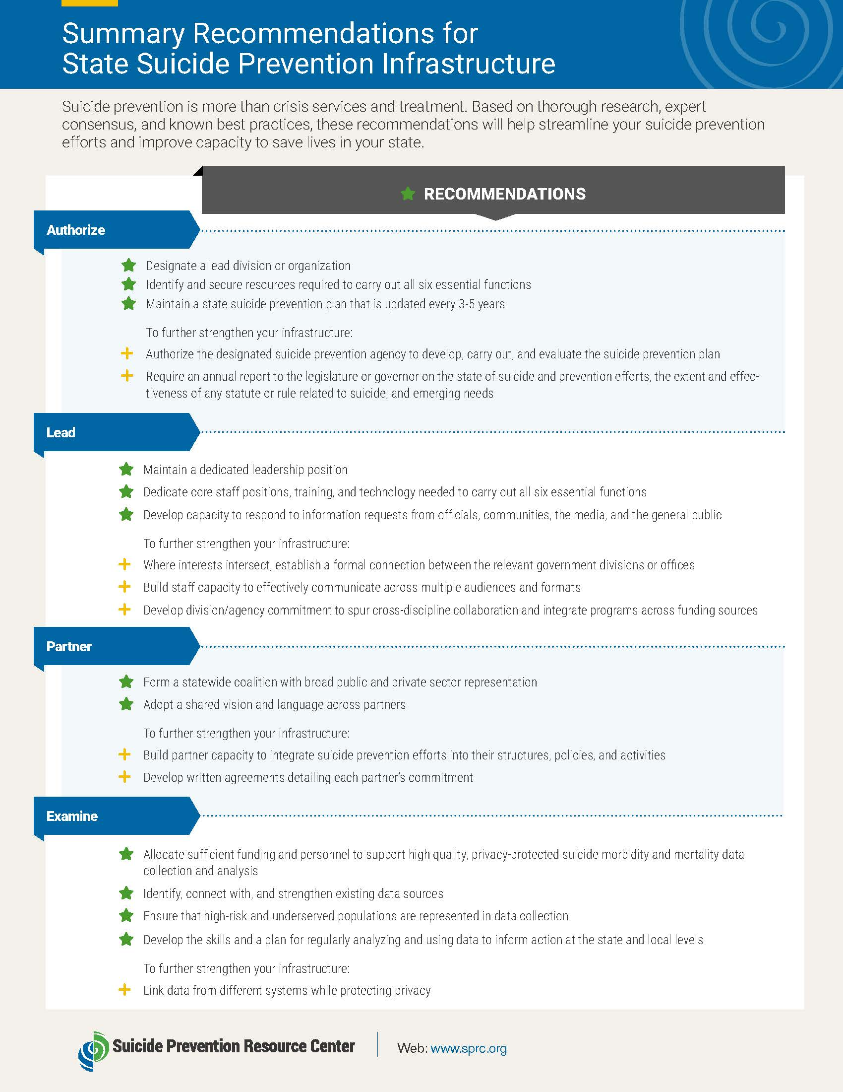
State Infrastructure Tools: Recommendations and Related Products
Summary Recommendations for State Suicide Prevention Infrastructure
This 2-page PDF provides a brief overview of Infrastructure Recommendations and contains an editable section to provide your audience with information relevant to your state.

Slide 13
State Infrastructure Tools: Recommendations and Related Products
State Infrastructure Success Stories
This series of success stories highlights real-life examples of nine states that built infrastructure essential for advancing suicide prevention, including:
Arizona
Colorado
Massachusetts
Minnesota
New Hampshire
New York
Utah
Tennessee
Texas

Slide 14
State Infrastructure Tools: Recommendations and Related Products
Building State Infrastructure in Your State (Archived Webinar)
In this webinar, presenters from SPRC, the American Foundation for Suicide Prevention, and NAMI New Hampshire explore the Infrastructure Recommendations and how you can use them to build suicide prevention infrastructure in your state.

Slide 15
State Infrastructure Tools: Recommendations and Related Products
Creating a Stronger Data Infrastructure for Suicide Prevention (Archived Webinar)
This webinar highlights six concrete recommendations for creating infrastructure to support data-driven decision-making. Presenters from Colorado and Texas also share examples of how these recommendations have been applied in their states to build a stronger data infrastructure.

Slide 16
State Infrastructure Tools:
Recommendations and Related Products
Tools for Implementation
Getting Started Guide (PDF)
Essential Elements Assessment Tool (PDF)
Timeline Development Worksheet (PDF)
State Infrastructure Summary Checklist (PDF)
Suicide State Fact Sheets from AFSP (Webpage)
State Suicide Prevention Coordinator Position Descriptions (PDF)
For Champions
Notes:
Intro slide for “Tools for Implementation” section

Slide 17
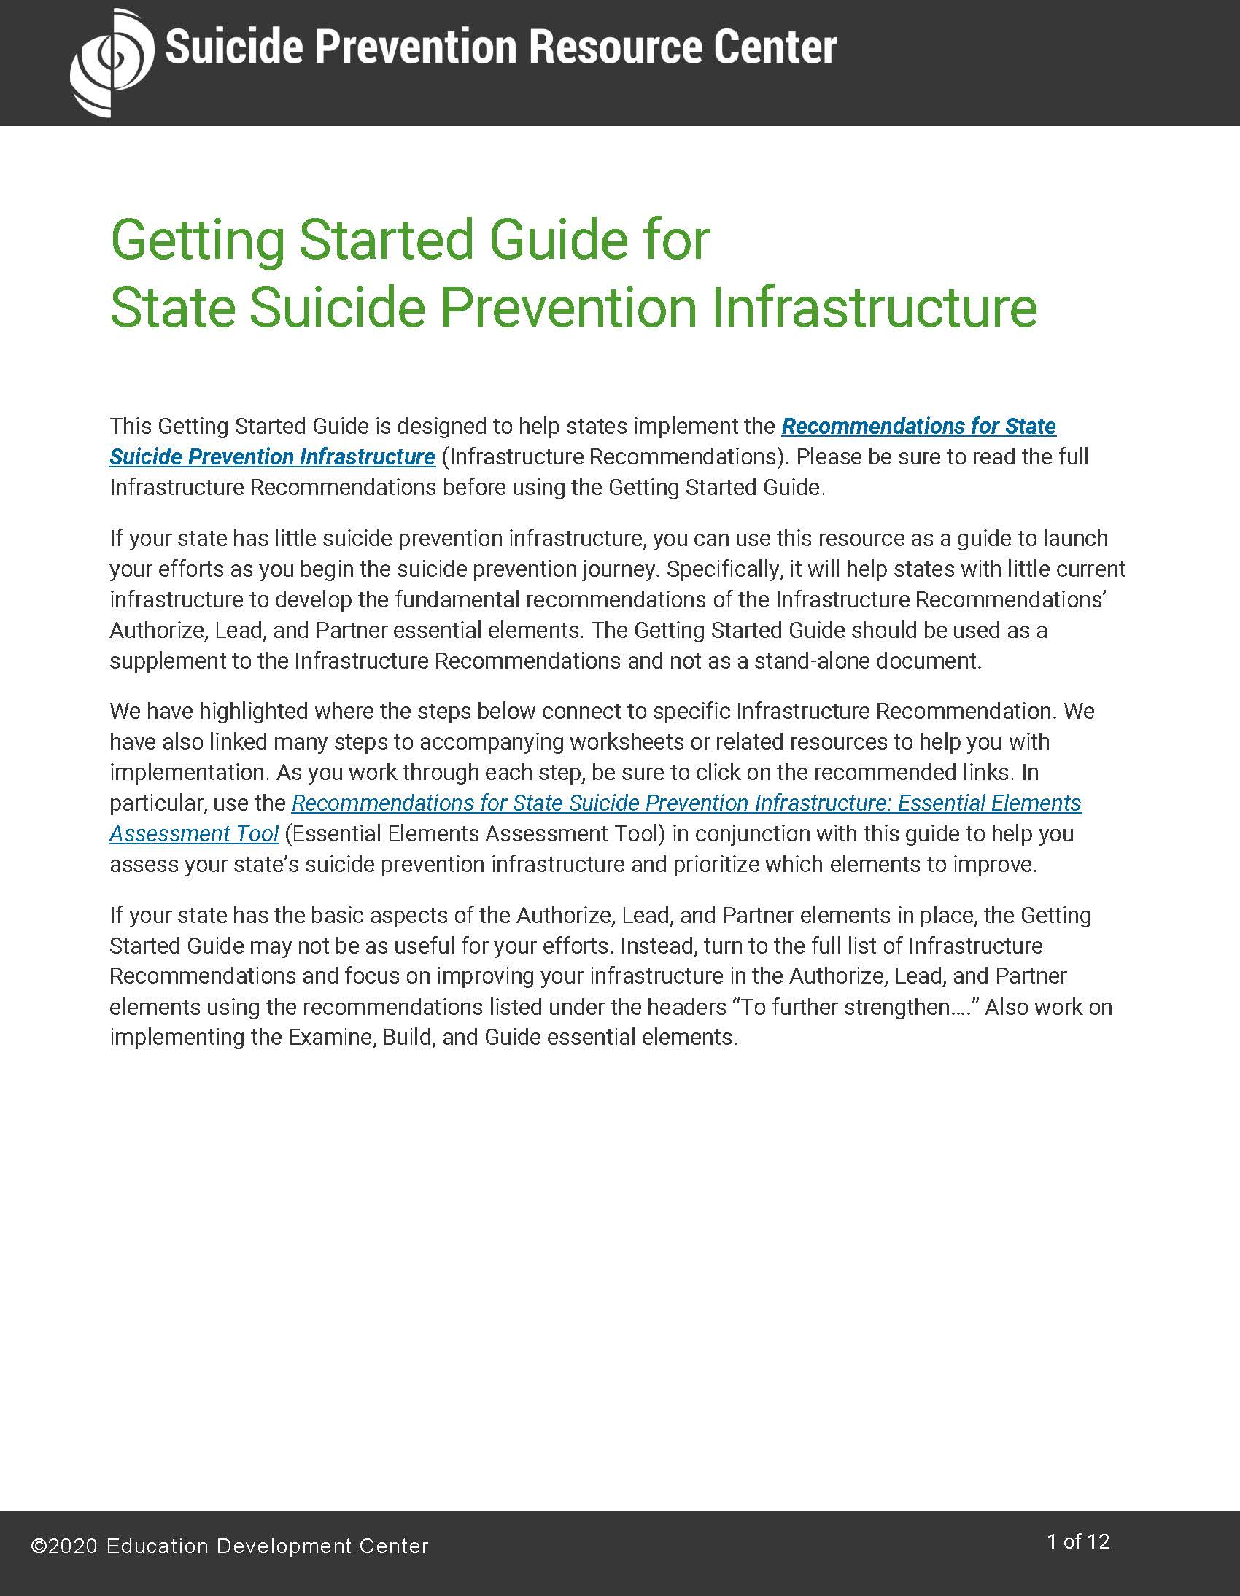
State Infrastructure Tools: Tools for Implementation
Getting Started Guide
This resource is designed to help states with little suicide prevention infrastructure put in place the Authorize, Lead, and Partner essential elements of the Infrastructure Recommendations.

Slide 18
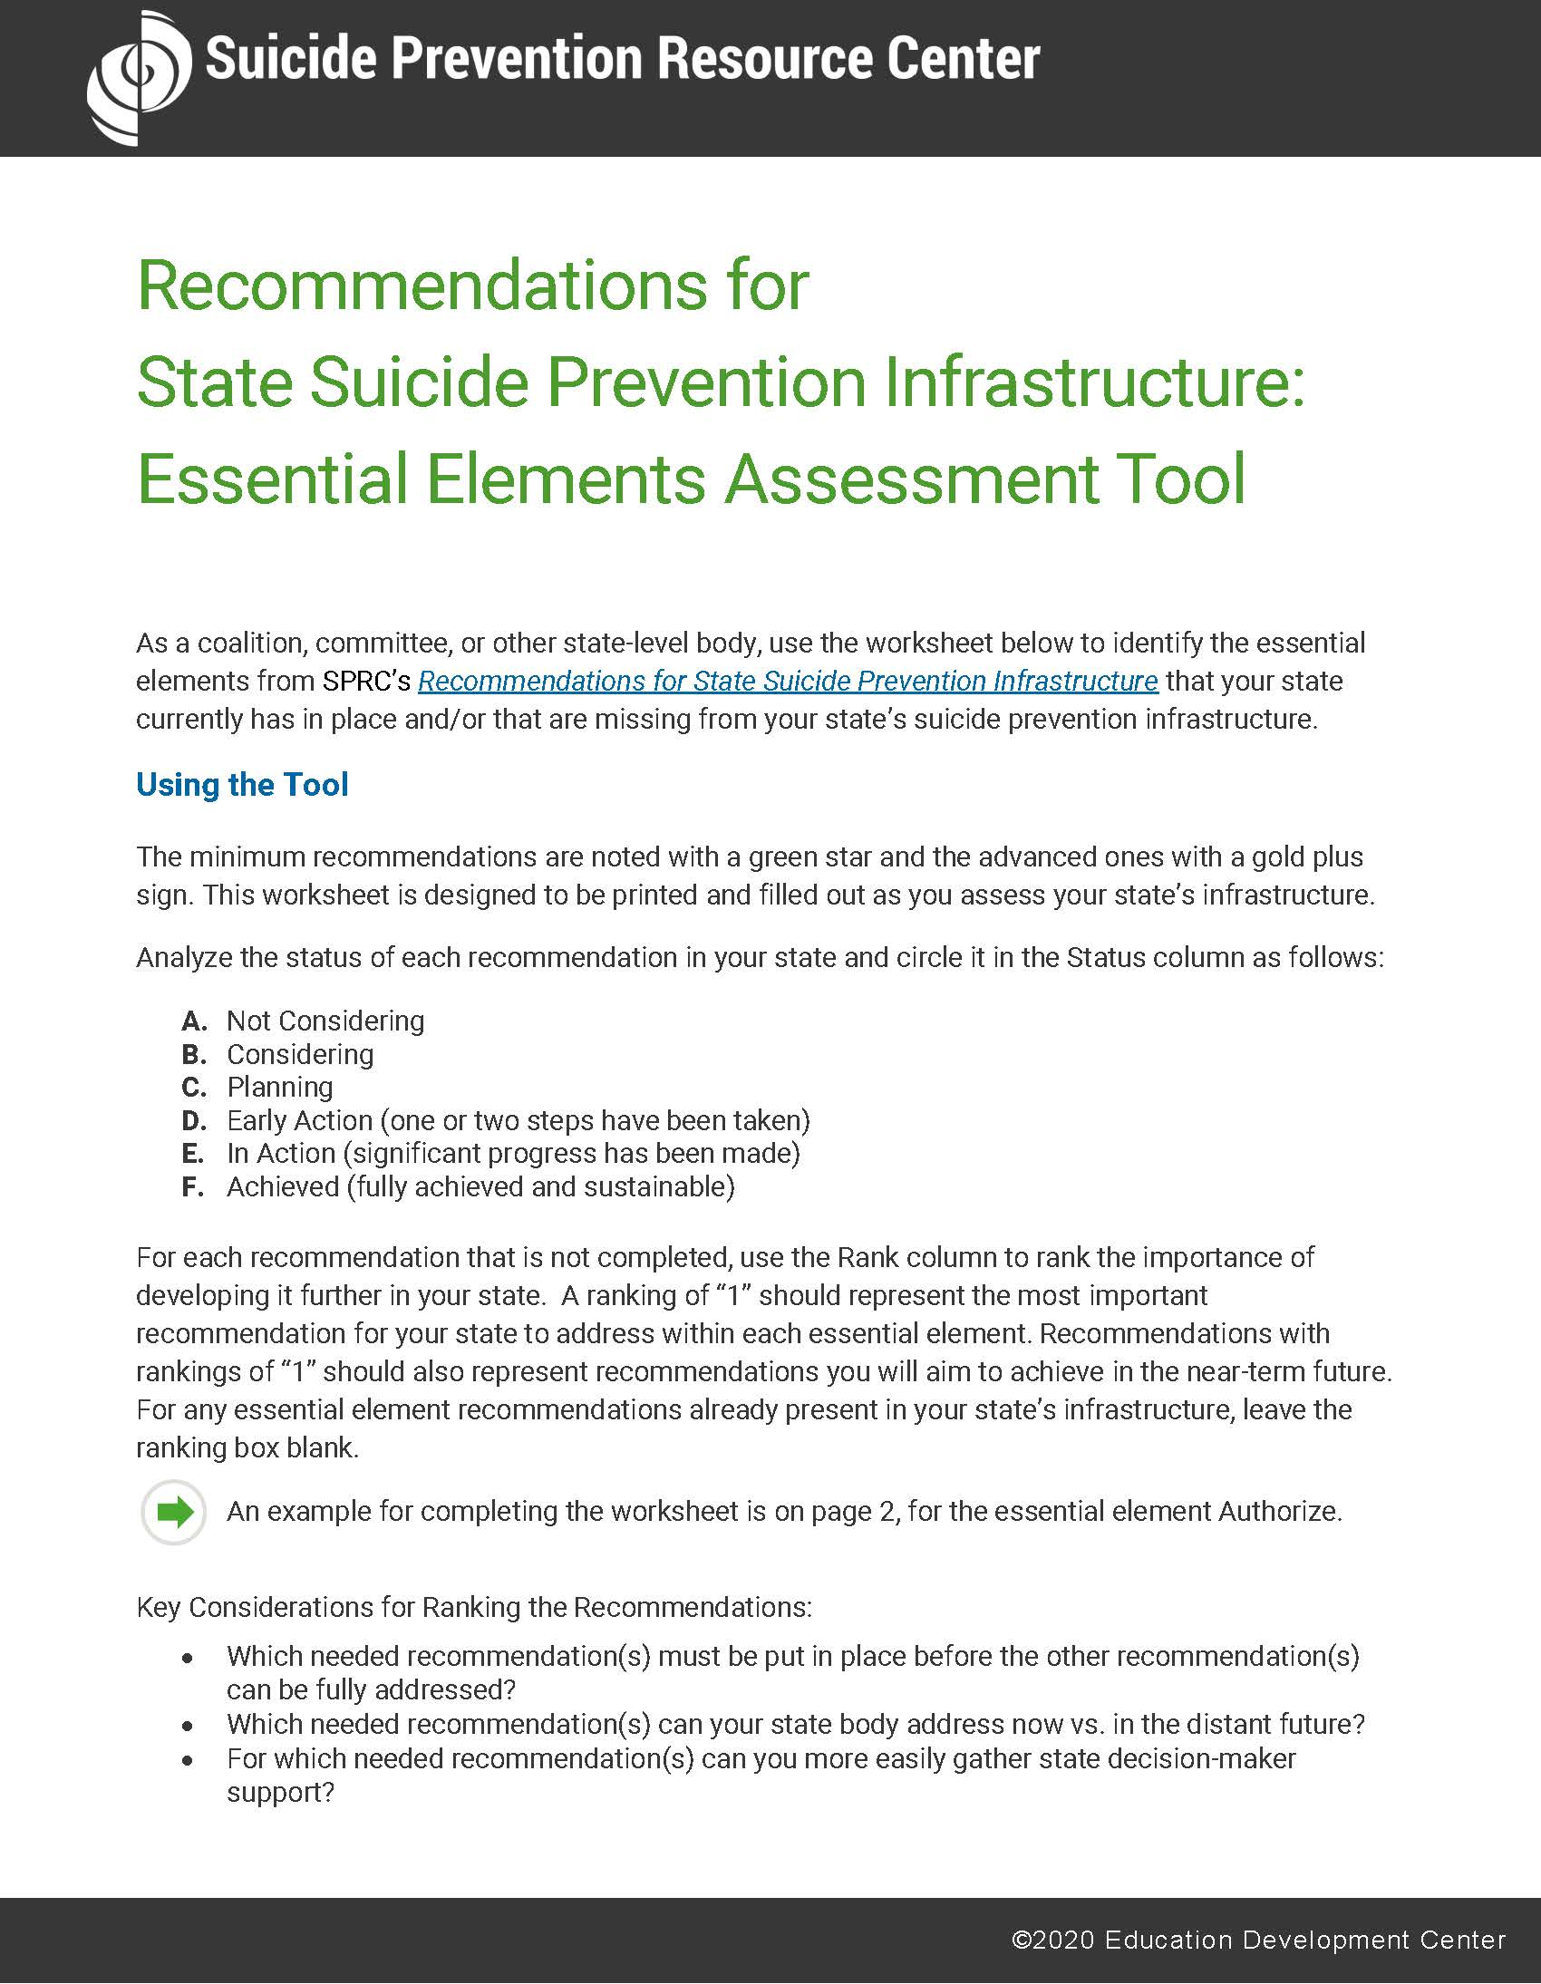
State Infrastructure Tools: Tools for Implementation
Essential Elements Assessment Tool
This worksheet can help you identify essential elements from the Infrastructure Recommendations that your state currently has in place and/or that are missing from your state’s suicide prevention infrastructure.

Slide 19
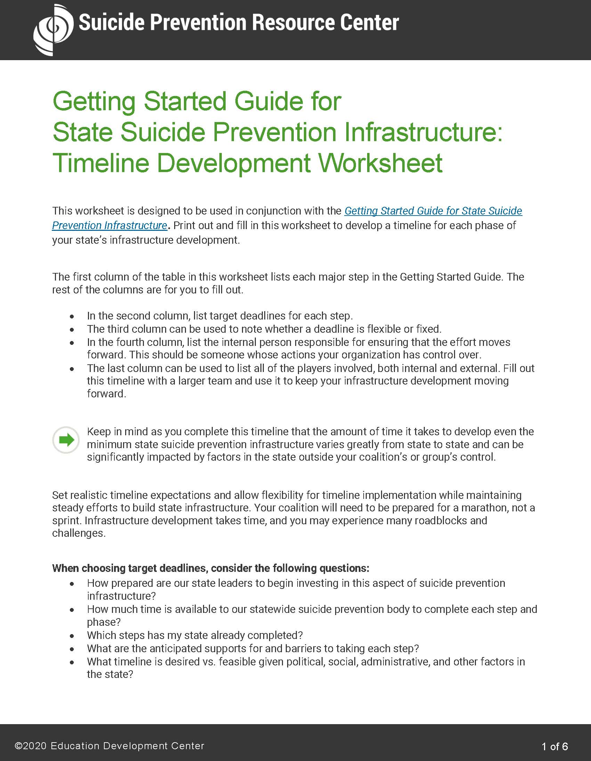
State Infrastructure Tools: Tools for Implementation
Timeline Development Worksheet
This worksheet is designed to help you develop a timeline for each phase of your state’s infrastructure development in conjunction with the Getting Started Guide.​

Slide 20
State Infrastructure Tools: Tools for Implementation
State Infrastructure Summary Checklist
This checklist is an interactive version of the summary recommendations and provides users with an editable section to add notes.​

Slide 21
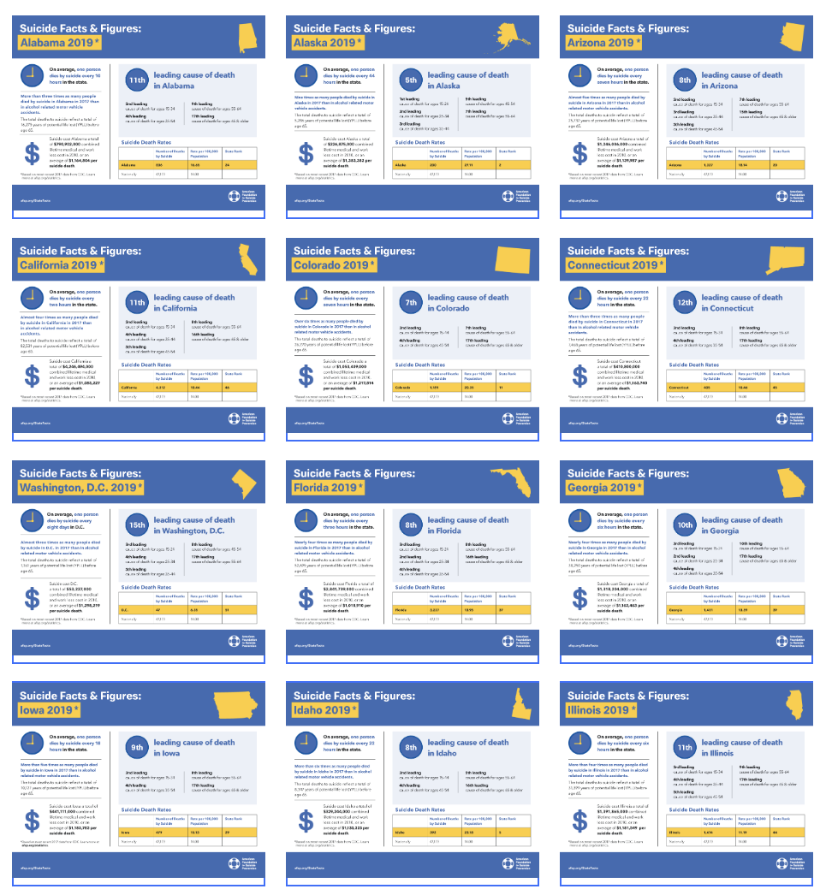
State Infrastructure Tools: Tools for Implementation
State Suicide Fact Sheets
These fact sheets from the American Foundation for Suicide Prevention (AFSP) contain state-specific information about existing suicide prevention leadership structure and legislation.
They also include data to help you make the case for improving infrastructure in your state.

Slide 22
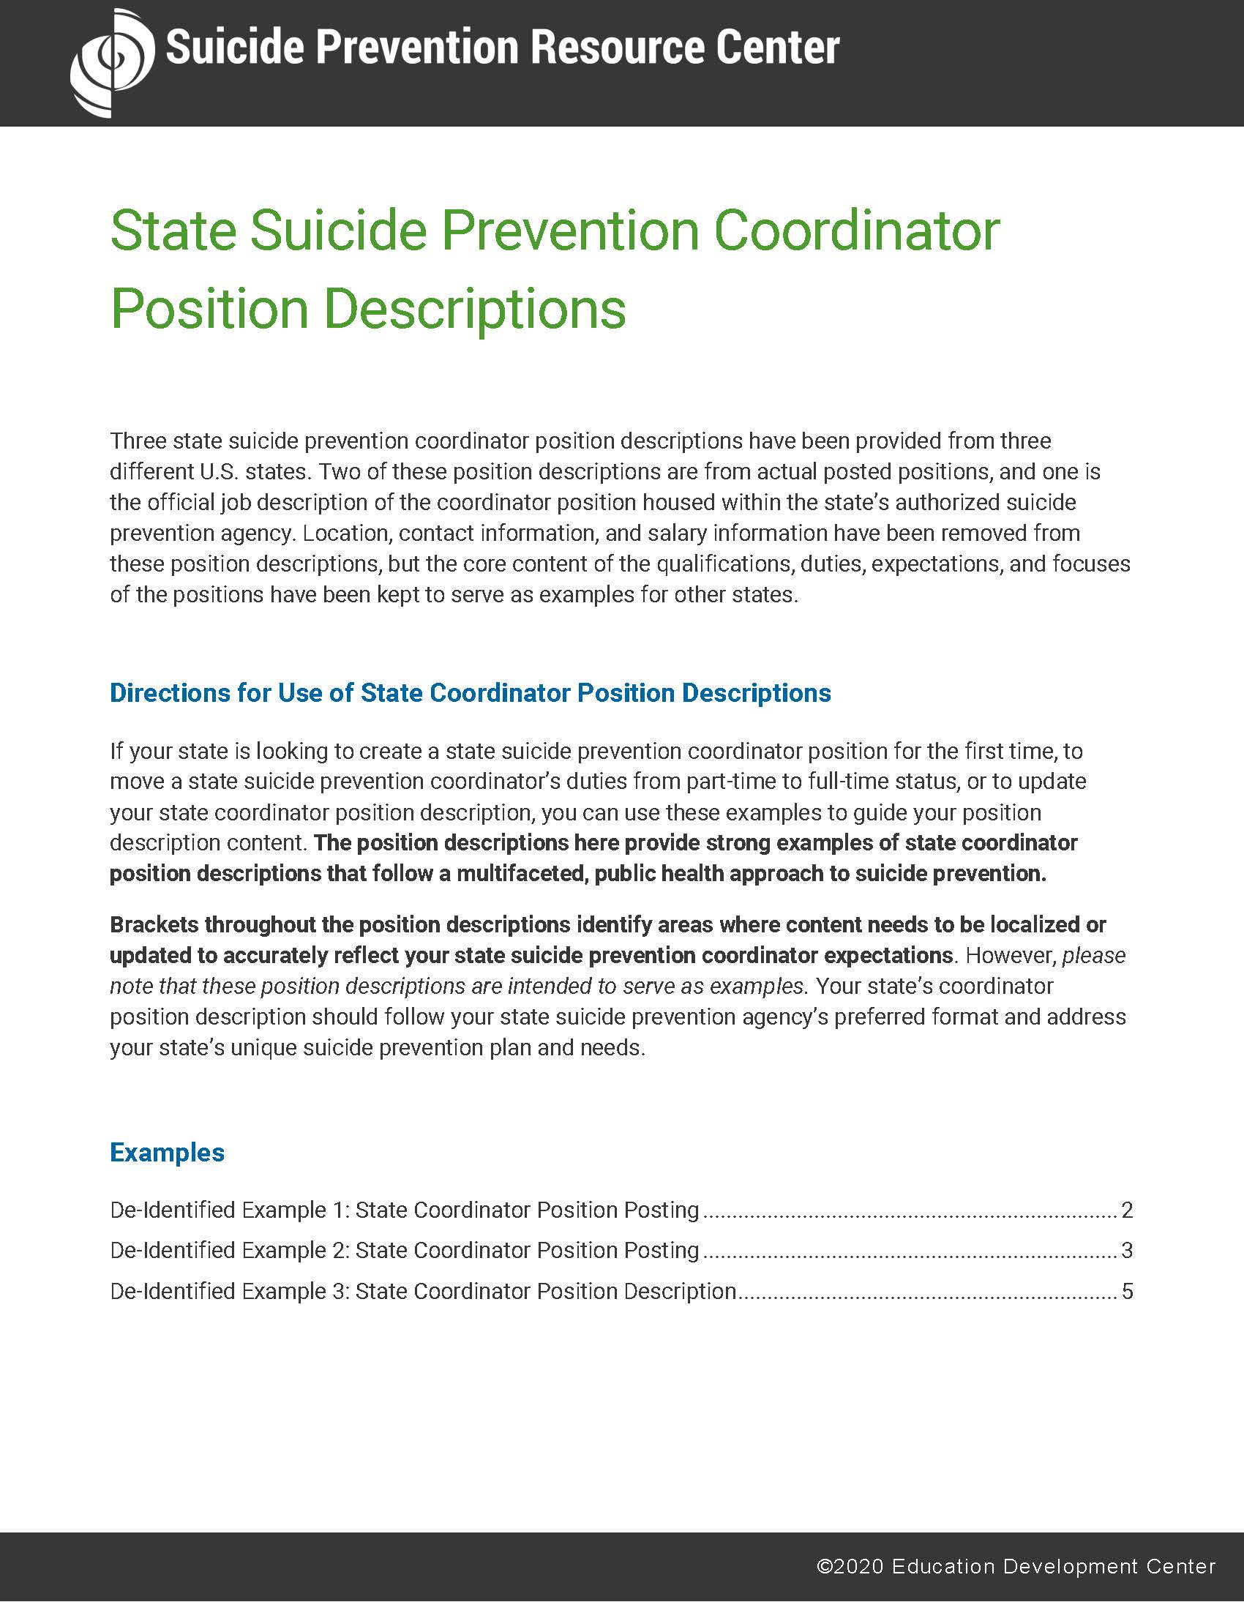
State Infrastructure Tools: Tools for Implementation
State Suicide Prevention Coordinator Position Descriptions
This packet of position descriptions contains real-life examples from three U.S. states that can be used in full or in part by any state.​

Slide 23
State Infrastructure Tools:
Recommendations and Related Products
Tools for Implementation
For Champions
From AFSP: Using SPRC’s State Suicide Prevention Infrastructure Recommendations (PDF)
Cover Letter for State Policy Makers (PDF)
State Infrastructure Promotional Slides (PPT)
Notes:
Intro slide for “For Champions” section

Slide 24
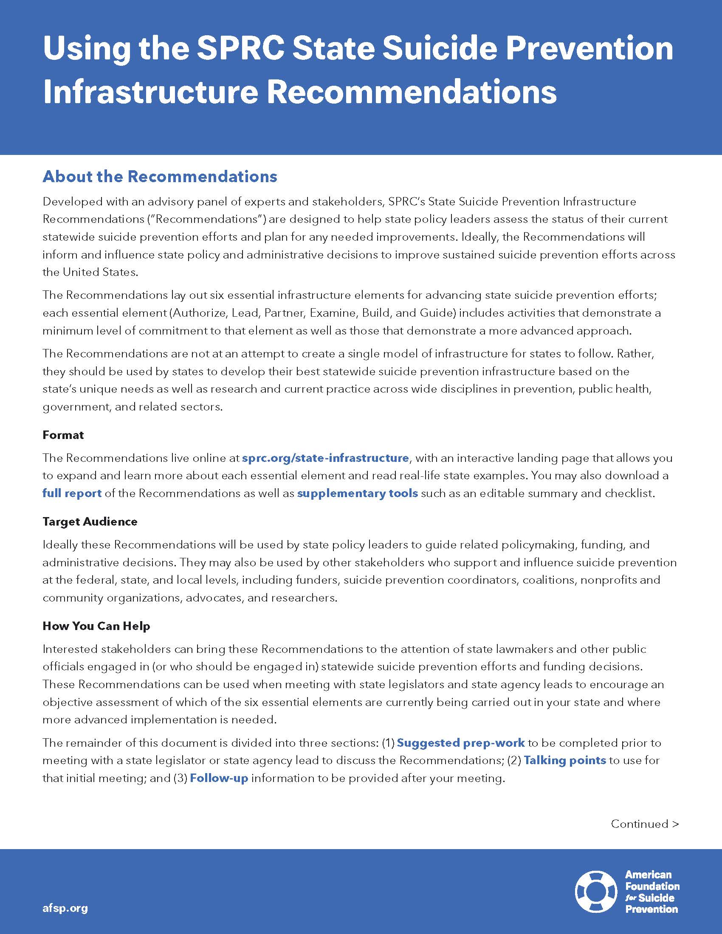
State Infrastructure Tools: For Champions
Using SPRC’s State Suicide Prevention Infrastructure Recommendations
​This resource developed by the American Foundation for Suicide Prevention (AFSP) can help you prepare for, meet with, and follow up with policy makers regarding your state’s infrastructure.

Slide 25
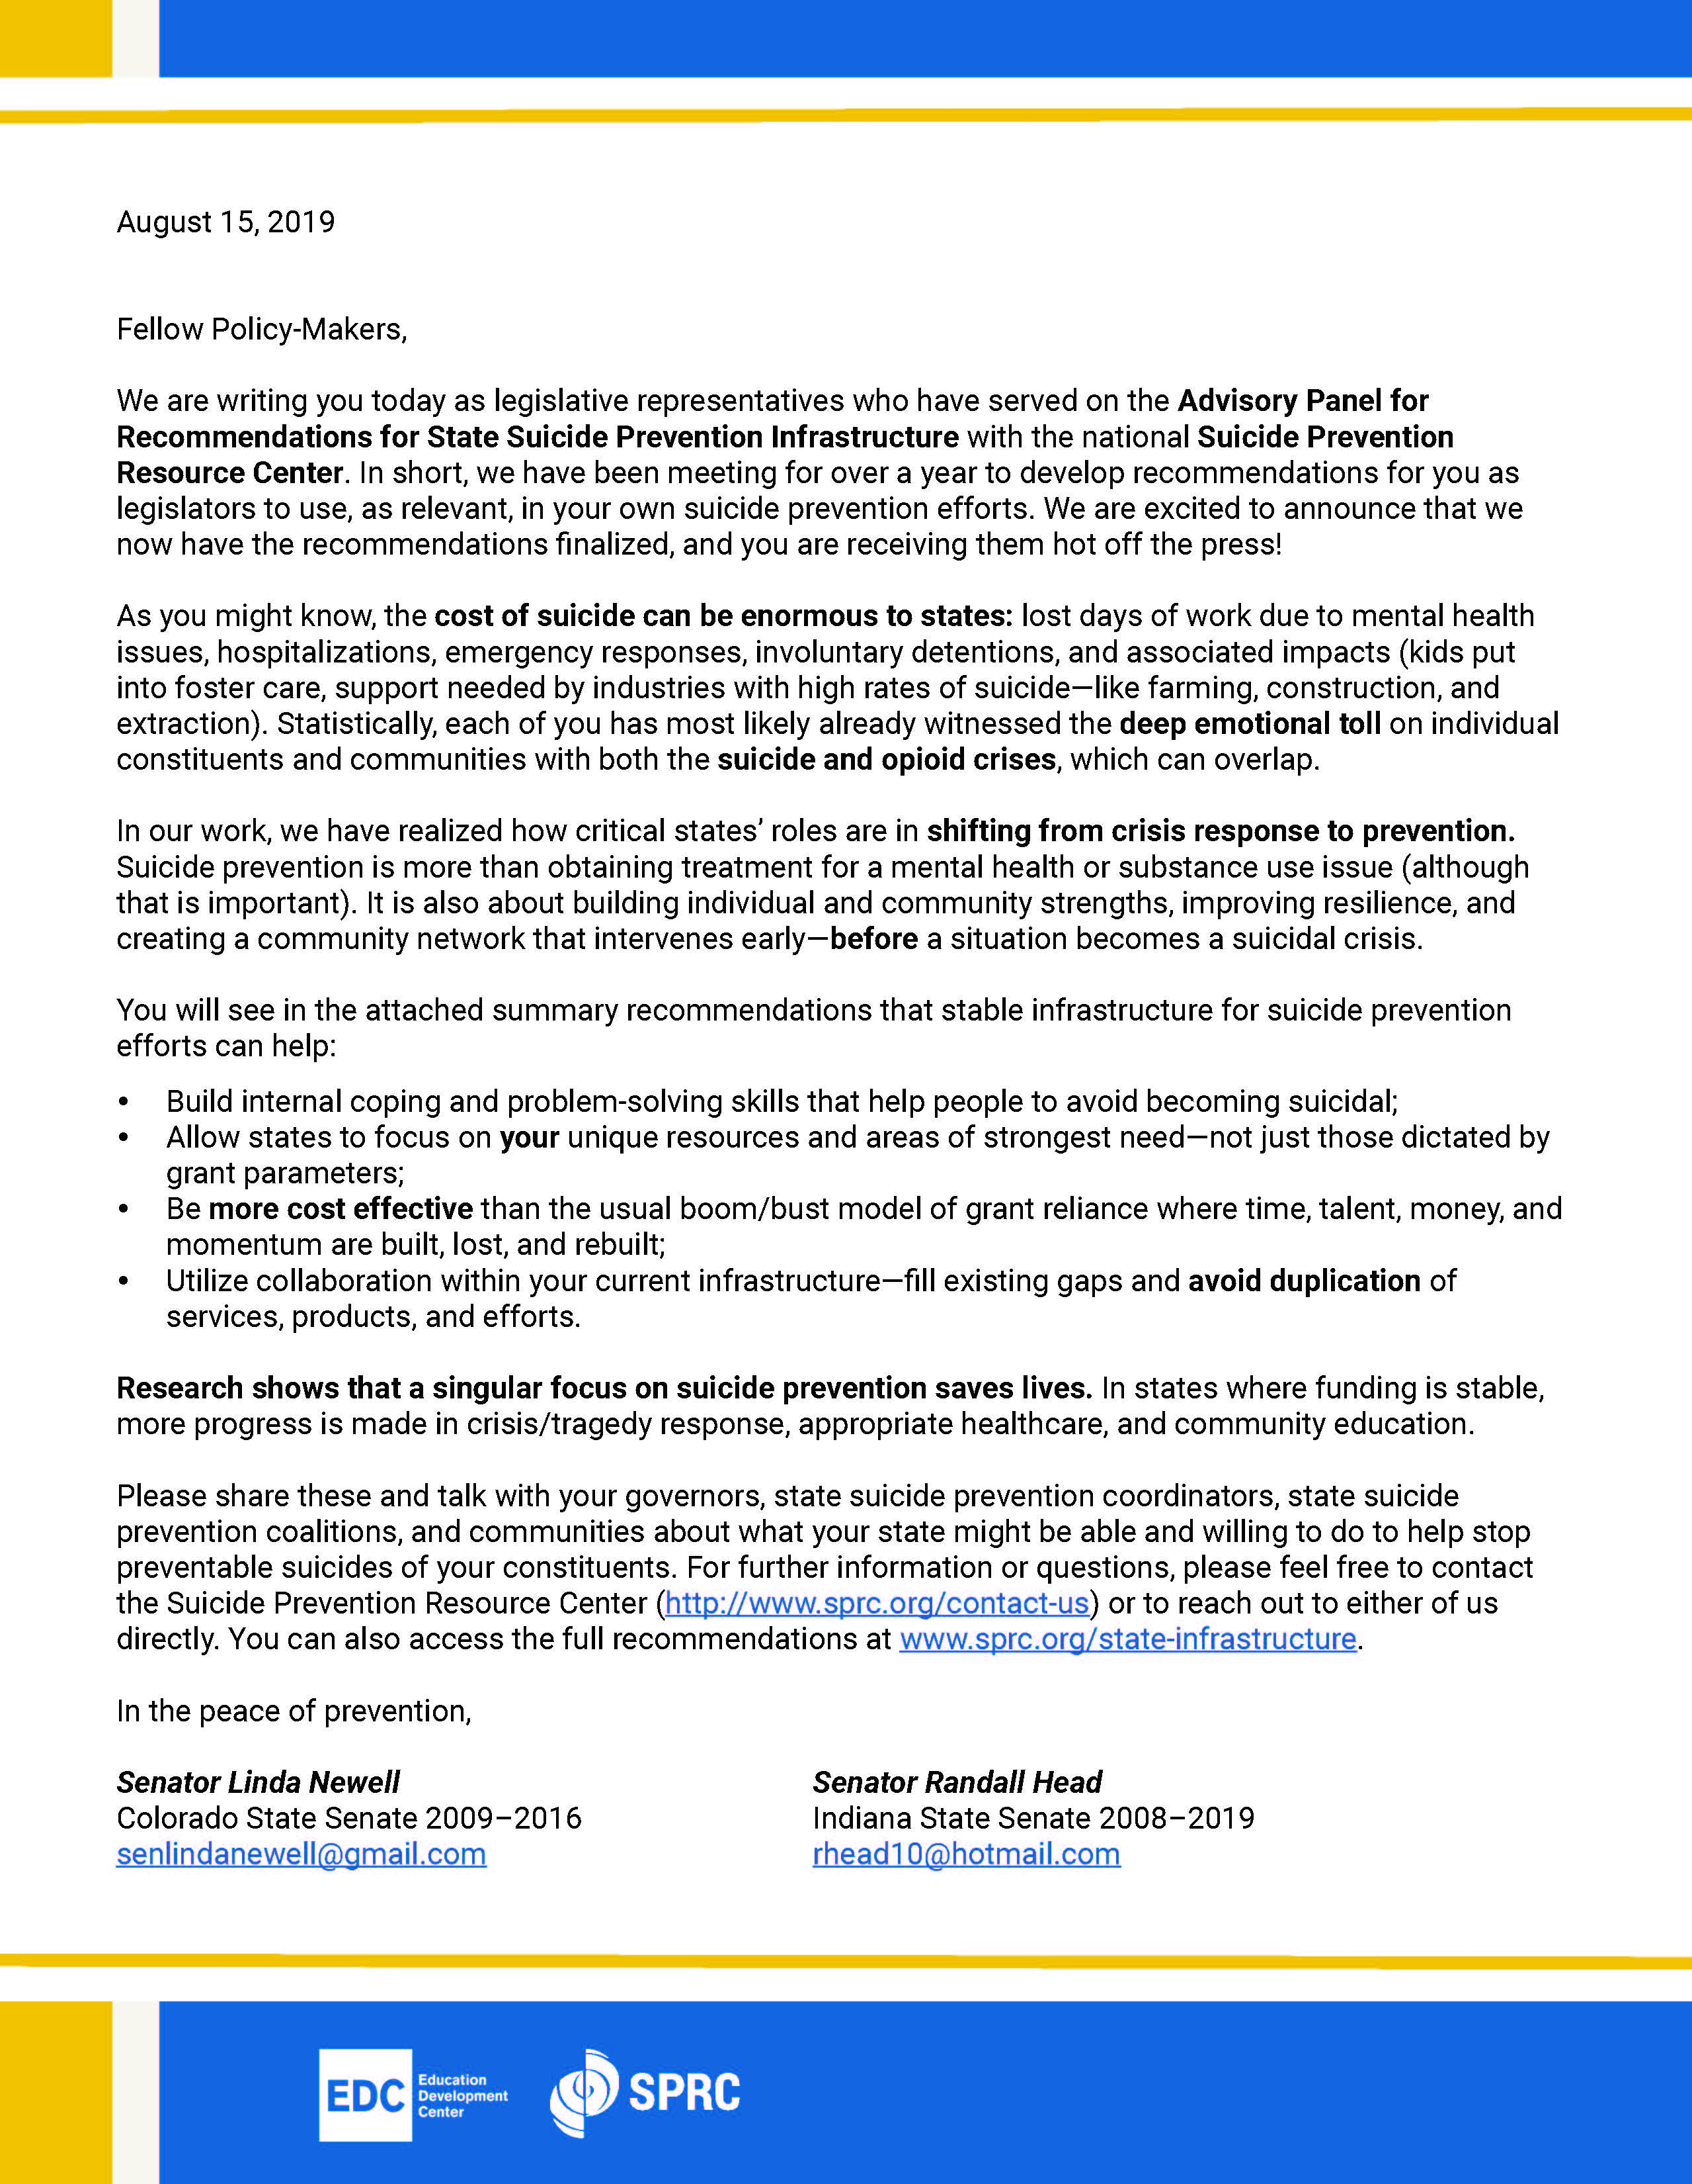
State Infrastructure Tools: For Champions
Cover Letter for State Policy Makers
​This cover letter, written by former state Senators Linda Newell (CO) and Randall Head (IN), makes a compelling case for states to shift their focus from crisis response to prevention. You can use this resource when talking with your state’s policymakers about suicide prevention infrastructure.

Slide 26
State Infrastructure Tools: For Champions
State Infrastructure Promotional Slides
This PowerPoint slide set can be downloaded and used in your presentations to promote the Infrastructure Recommendations. It provides a brief overview of the recommendations, as well as a deep dive into the many tools available to support implementation.

